Slide 1
D&D Seekers
Ben, Grant, Nick and Bailey

Slide 2
The Party
Ben Martin – The great wizard of the glade. The code is strong with this one. Always willing to lend a helping hand in our fierce battle. His quick wittedness and powers in JavaScript brought us to victory.
Grant Royseth – The valiant knight of the shade. Well-known for his ability to adapt and defend against the darkness of APIs. He was summoned to answer the threat of API.
Nick Mullenmeister – The dreamer of the lost. Happens to know a thing or two about JavaScript and CSS, but often finds himself mystified. Does his best, though. Could someday become a coding sorcerer
Bailey Behning – The suzerain of the realm. Fights for our cause, the sake of coding and the betterment of all coders.

Slide 3

Using the right monsters is the most important part of building any D&D encounter. But it’s been 7+ since 5th Edition launched, and there are now hundreds of creatures scattered across dozens of source books. Often, these books are badly indexed and arranged. With a huge range of Challenge Ratings (monster’s level), finding the right monster can be a huge pain.
Fortunately, with the magic of APIs and open5e, there’s now an easy way to look up creatures of a certain Challenge Rating across all of 5th Edition!

Slide 4
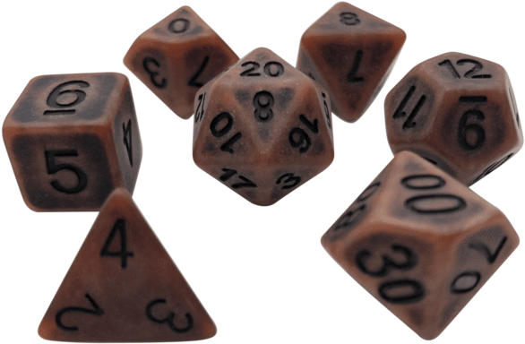
As a DM (Dungeon Master) of Dungeons & Dragons:
I want to be able to quickly and easily look up monsters I can use for my encounters
I want to tell at a glace what type the creature is
I want to know its ability scores (Strength, Dexterity etc.)
I want to be able to make a list of monsters I’m considering using
I want my list to be saved between sessions
I want to be inspired by pictures of delicious food

Slide 5

The Process

Slide 6


Questions?

